Slide 1
Telegraf Plugin for Cloud Service Billing Monitoring
Presented by : Syeda Sidra Quadri
Under the guidance : Mr.Dheeraj and
Ms. Sneha Potdar

Slide 2
Overview:
Tools used for the project.
Project overview.
Project Implementation phases.
Learning outcome.
Conclusion and next steps.

Slide 3



Tools Used For The Project:
A flexible and powerful open-source agent used for collecting, processing, and sending metrics to a variety of outputs.
A widely-used open-source tool for creating dashboards and visualizations from time-series data.
A time-series database that stores high-volume data, over time. It is optimized for fast reading and writing of data.
Telegraf

Slide 4
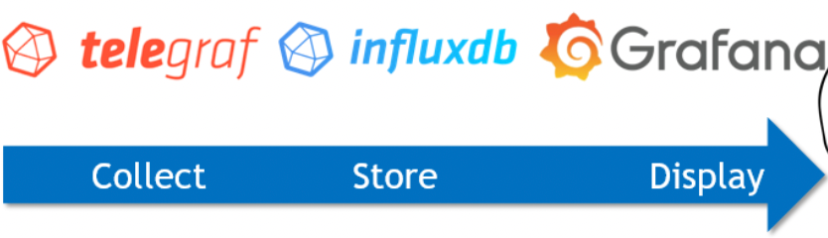
Project Overview:
Objective: Develop a Telegraf plugin to monitor cloud service billing metrics, track costs, and optimize resource usage.
Outcome: Deliver a plugin that integrates with cloud services and stores billing data in InfluxDB, and visualize it for better decision-making in cloud cost management.

Slide 5
Project Implementation Phases:
Phase1 Phase2 Phase3 Phase4
Data Processing & Storage
Visualization Setup
Testing & Refinement
Plugin Development

Slide 6

Learning Outcomes:
Technical Skills: Gained hands-on experience with plugin development, and working with cloud service data.
Time-Series Databases: Experience with InfluxDB for storing and querying time-series data effectively.
Visualization Tools: Developed skills in using Grafana to create interactive dashboards for data visualization.
Cloud Billing Insights: Understanding how cloud providers structure billing and how to track and manage those costs.

Slide 7

Conclusion & Next Steps:
Conclusion:
The Telegraf plugin provides an efficient solution for monitoring cloud billing metrics, enabling organizations to reduce costs and optimize resources. By leveraging InfluxDB and Grafana, the project offers real-time insights into cloud usage.
Next Steps:
Refine the Plugin: Continue improving the Telegraf plugin for accuracy and more metrics.
Feedback: Present the working version to supervisors or stakeholders for feedback and suggestions.
Further Learning: Explore additional integrations or advanced features like cost prediction or forecasting.

Slide 8
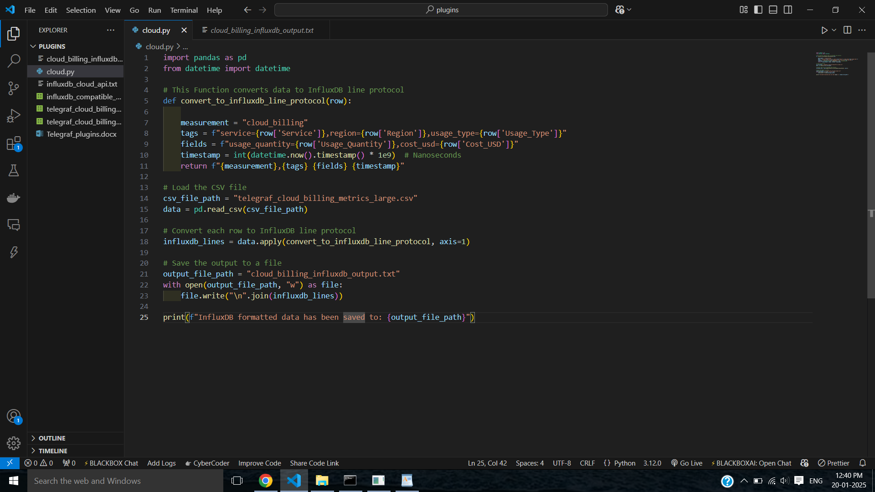
Snapshot of the code

Slide 9
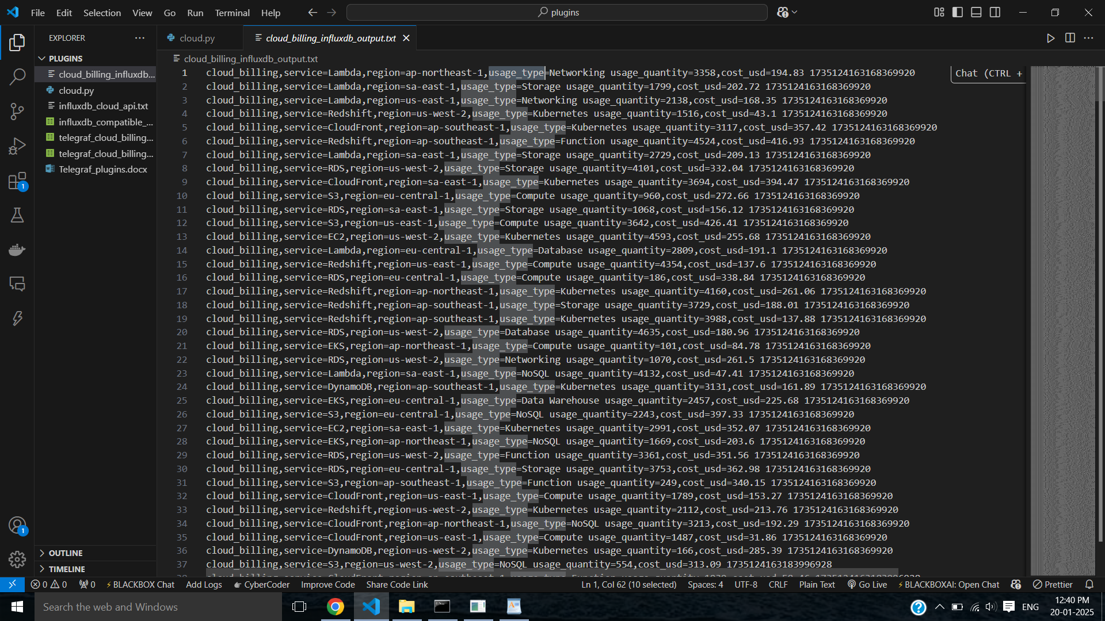
Output of the code

Slide 10
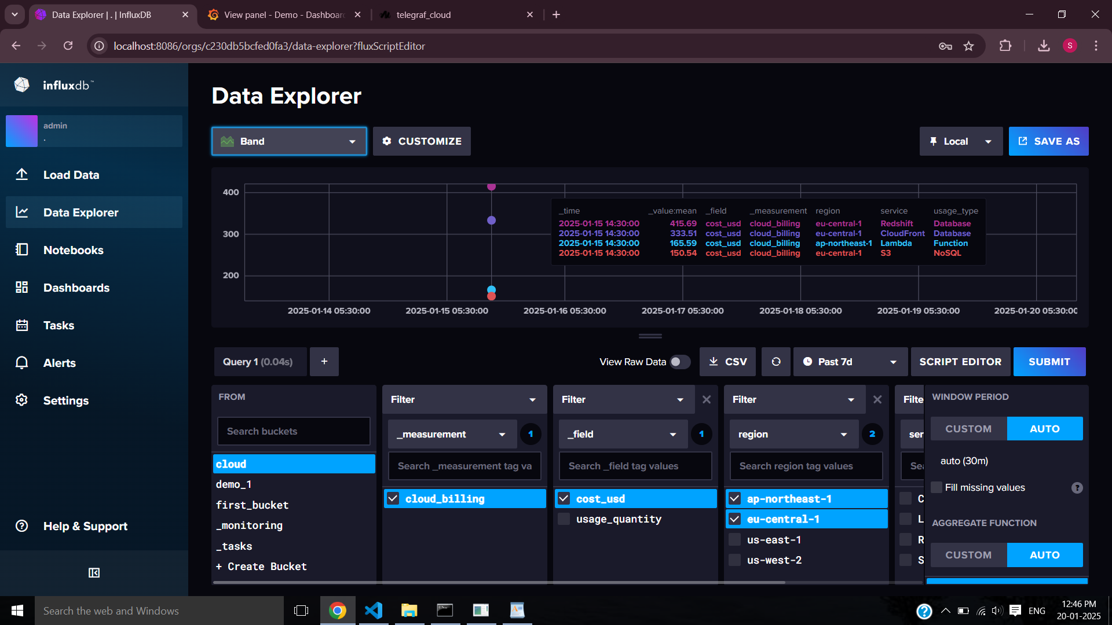
Data stored in InfluxDB

Slide 11
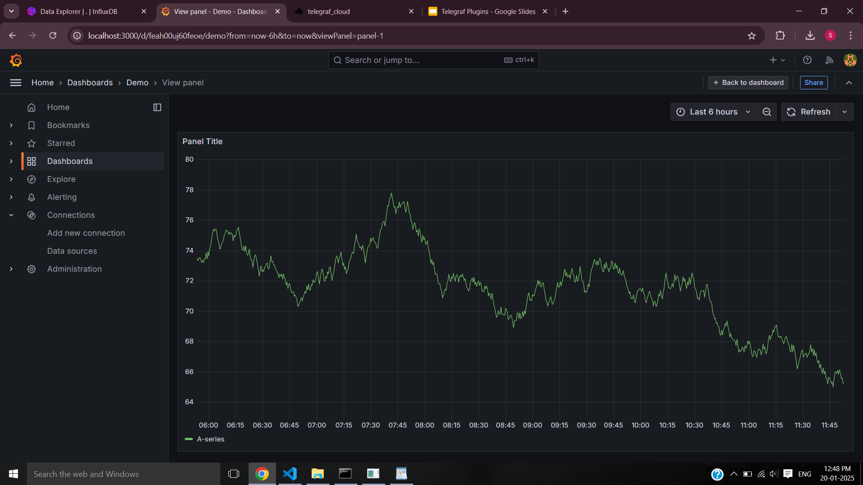
Visualization in Grafana

Slide 12
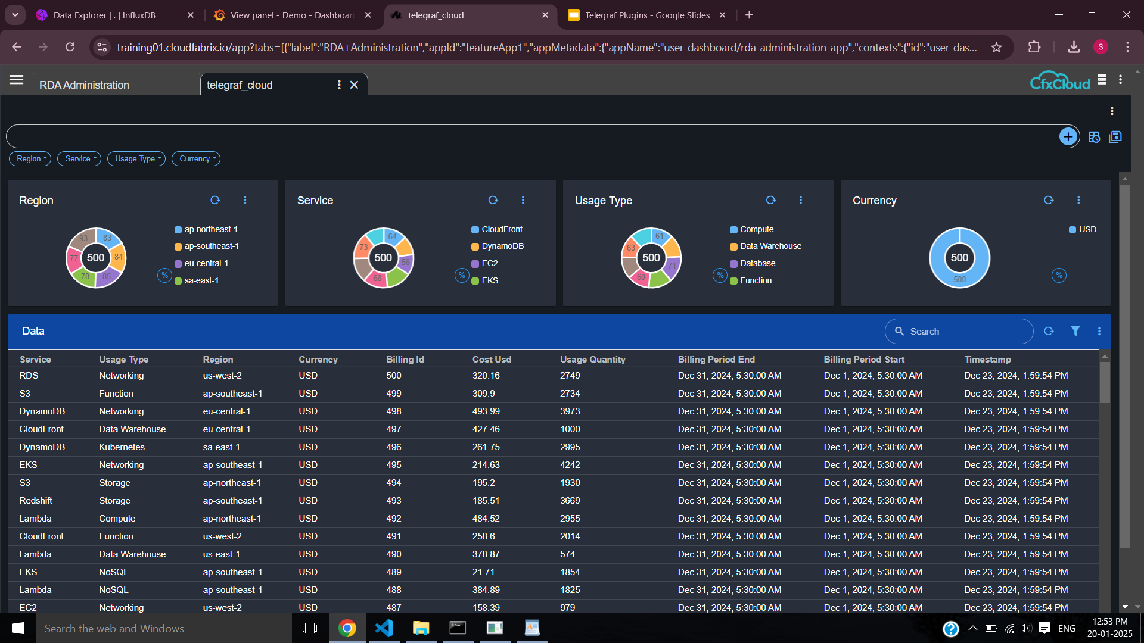
Dashboard

Slide 13
THANK YOU

